Slide 1
Sales performance dashboard
Data analysis internship
Task – 4
Tools used – Power BI
Prepared by –
Aleena Ahmad

Slide 2
Project Objective
Objective
Design an interactive dashboard for business stakeholders to monitor performance and support decision-making.
KPIs Used
• Total Sales
• Total Profit
• Growth Trend
Features
• Interactive Slicers
• Time-Series Analysis
• KPI Cards
• Visual Reports

Slide 3
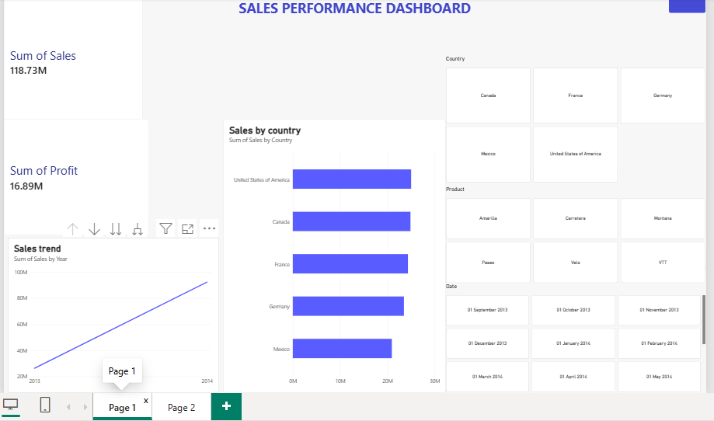
Dashboard Components
Dashboard Includes:
Sales KPI Card
Profit KPI Card
Sales Trend Line Chart
Sales by Country Bar Chart
Sales by Segment Donut Chart
Country, Product and Date Filters

Slide 4
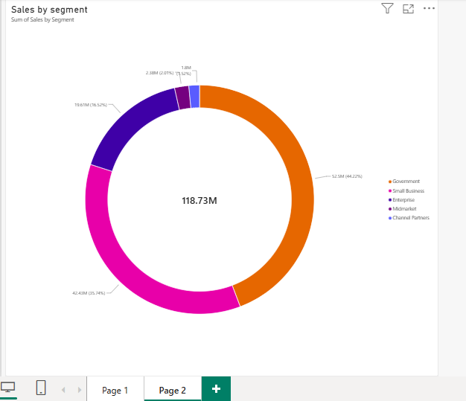
Key Insights
Key Findings
• Overall sales amounted to 118.73M with a profit of 16.89M.
• The company experienced a positive sales trend over the analyzed period.
• The United States emerged as the leading market by sales volume.
• Government and Small Business segments together accounted for the majority of total revenue.
• Channel Partner sales represented the lowest contribution and may require strategic attention.
• Interactive filters allow stakeholders to analyze performance by country, product, and date.

Slide 5
Conclusion
The dashboard provides a clear overview of sales performance, profitability, regional distribution, and customer segments. Interactive slicers enable users to explore trends and make data-driven business decisions efficiently.

